Slide 1
Notas de aula
Introdução à Física Computacional
Prof. Gerson – UFU – 2019
Atendimento:
  Sala 1A225
  Email: gersonjferreira@ufu.br
  Webpage: http://gjferreira.wordpress.com
  Horário: sextas-feiras 16:00 – 16:50

Slide 2

Use: g = 9, γ = 0.5, v(0) = 0
Ordinary differential equations
→ initial value problems
Example: free fall and terminal velocity
Forces:
→ gravity
→ drag
Terminal velocity:
Applying Newton’s 2nd law:
Full solution:
+ initial condition: v(0) = 0
v(t)
t

Slide 3
Ordinary differential equations
→ How to solve it numerically?
1) Euler’s method → the “worst”… but very intuitive method
Problem prototype:
→ y = y(t) is the unknown function
→ f(t,y) is a given function that defines the problem
Taylor expansion of y(t + Δt) for Δt → 0
Replace the derivative by its
forward finite differences stencil

Slide 4
1) The Euler method – how to apply
Given the problem
… and the initial condition
Apply Euler’s recursion successively
initial condition →
0
Δt
2Δt
3Δt
...
...
t
From t=0 to Δt →
Plot the data:
From t=Δt to 2Δt →
t
y(t)
From t=2Δt to 3Δt →
0
Δt
2Δt
3Δt
...
y₀
y₁
y₂
y₃
...
...

Slide 5
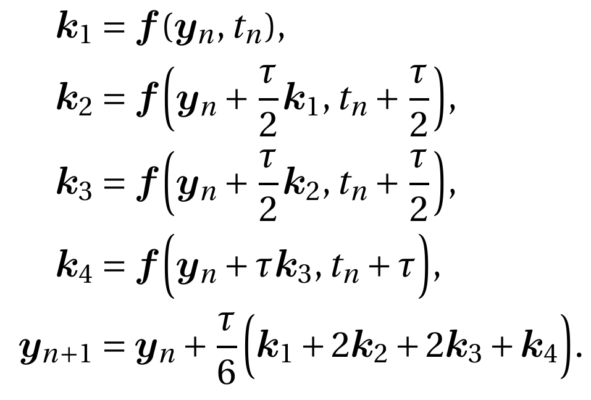
2) The Runge-Kutta methods
[link to Wikipedia]
→ Derivation of the RK2 method on my book
→ Derivation of the RK4 method on Numerical Calculus books
It’s a “simple” variation of Euler’s recursion
Problem prototype:
→ y = y(t) is the unknown function
→ f(t,y) is a given function that defines the problem
Jumping from t = n Δt → t = (n+1) Δt
Higher precision:
→ while Euler’s is a 2nd order method
→ RK4 is a 4th order method
Consequently, the time step
Δt on RK4 can be larger than in Euler

Slide 6



Pendulum: reduction of order
The 2nd order oscillator equation
→ can be solved using Verlet’s method,
but let’s try it with Euler and RK4 first
initial conditions:
x(0) = x₀
v(0) = v₀
Pendulum →
Reduction of order
Now it has the form of our prototype
… but now with vectors
with
and
Written in terms of the components of y

Slide 7
Your code is good… but better use scipy!!!
→ the python way… always use a library!
SciPy has methods that implement the adaptive RK4.5
→ solves using RK4
→ uses RK5 to check the error and define the optimal time step
→ scipy.integrate.solve_ivp [link]
Read the docs… check the examples… try to implement the pendulum
… and plot the results.
Tip: consider large initial angles → x₀ = 0.98π , and v₀ = 0
Later, change the acceleration to consider damping:

